Slide 1
YO BRONZE 2020 PLAN
CasperChang
19 July 2019

Slide 2
PLAN CONTENT
Bought Industry land
To Construct 3rd Plant
To Buy Automatic Sand Molding System
To Buy Robot For Load/Unload Motion
To Buy New Tapping Machine

Slide 3
Industry Park Land
Area：4640 m² (Width:40m Length:116m)
Time：May 2018(Apply) =>June(Decided)
October(Payment & Transfer Done)
Condition：Construction done within 2 years
Value：US＄1,700,000(NT$5200W)

Slide 4
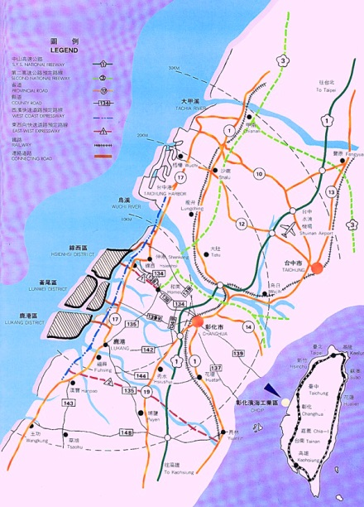
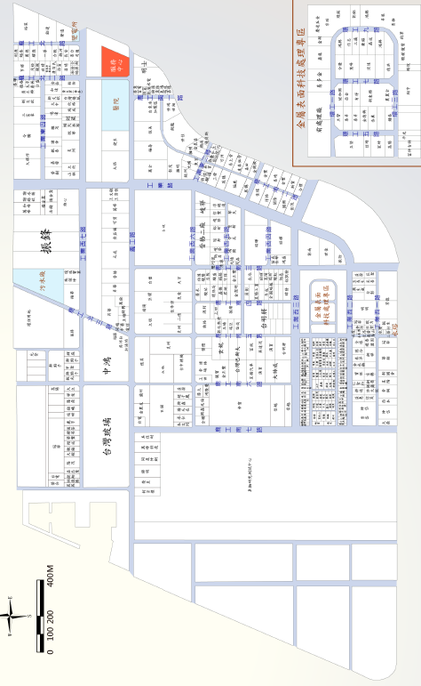
Land Location
YO
3rd Plant

Slide 5
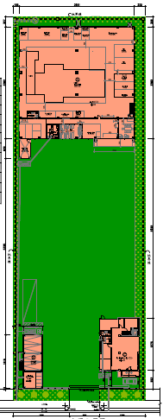
The 3rd Plant Of YO Bronze

Slide 6
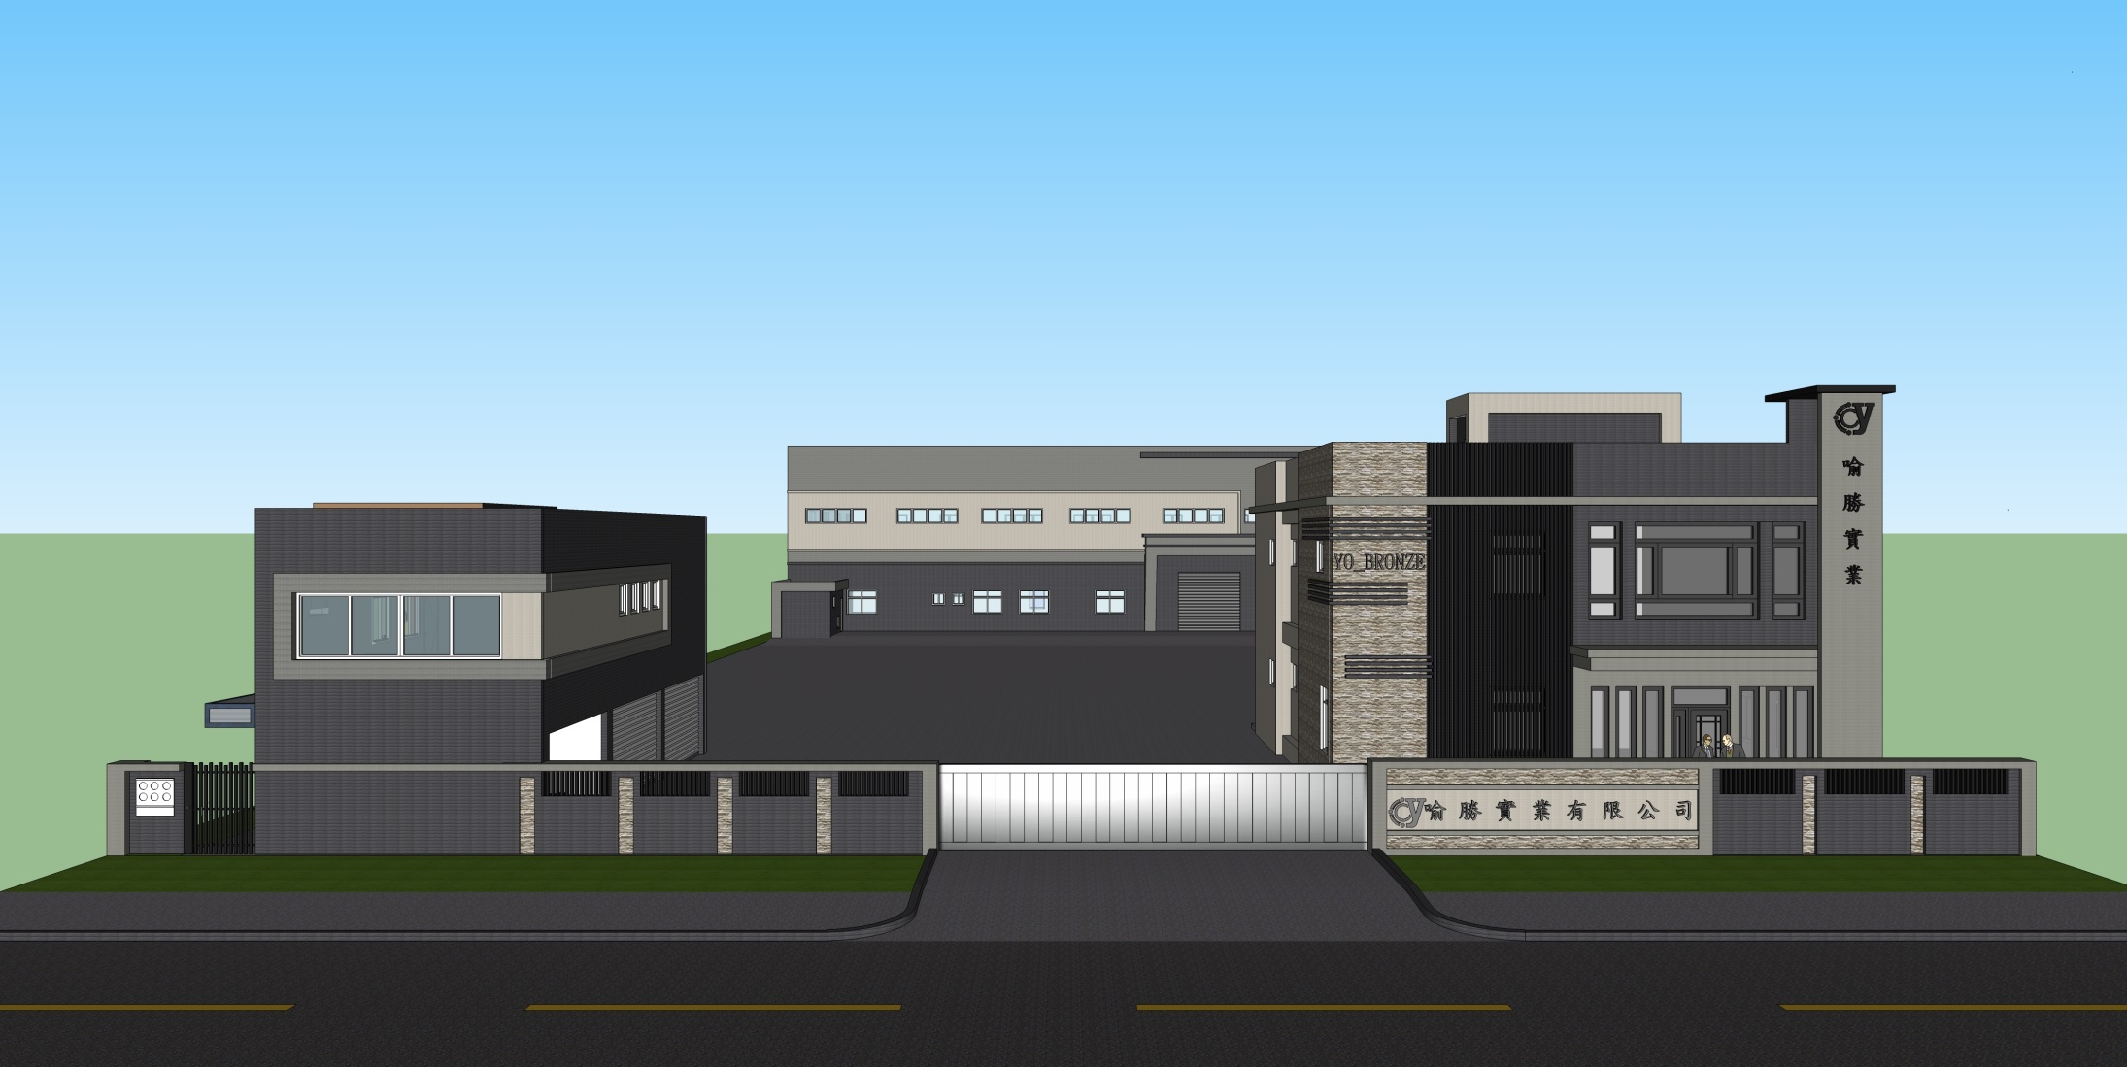
The 3rd Plant Of YO Bronze

Slide 7
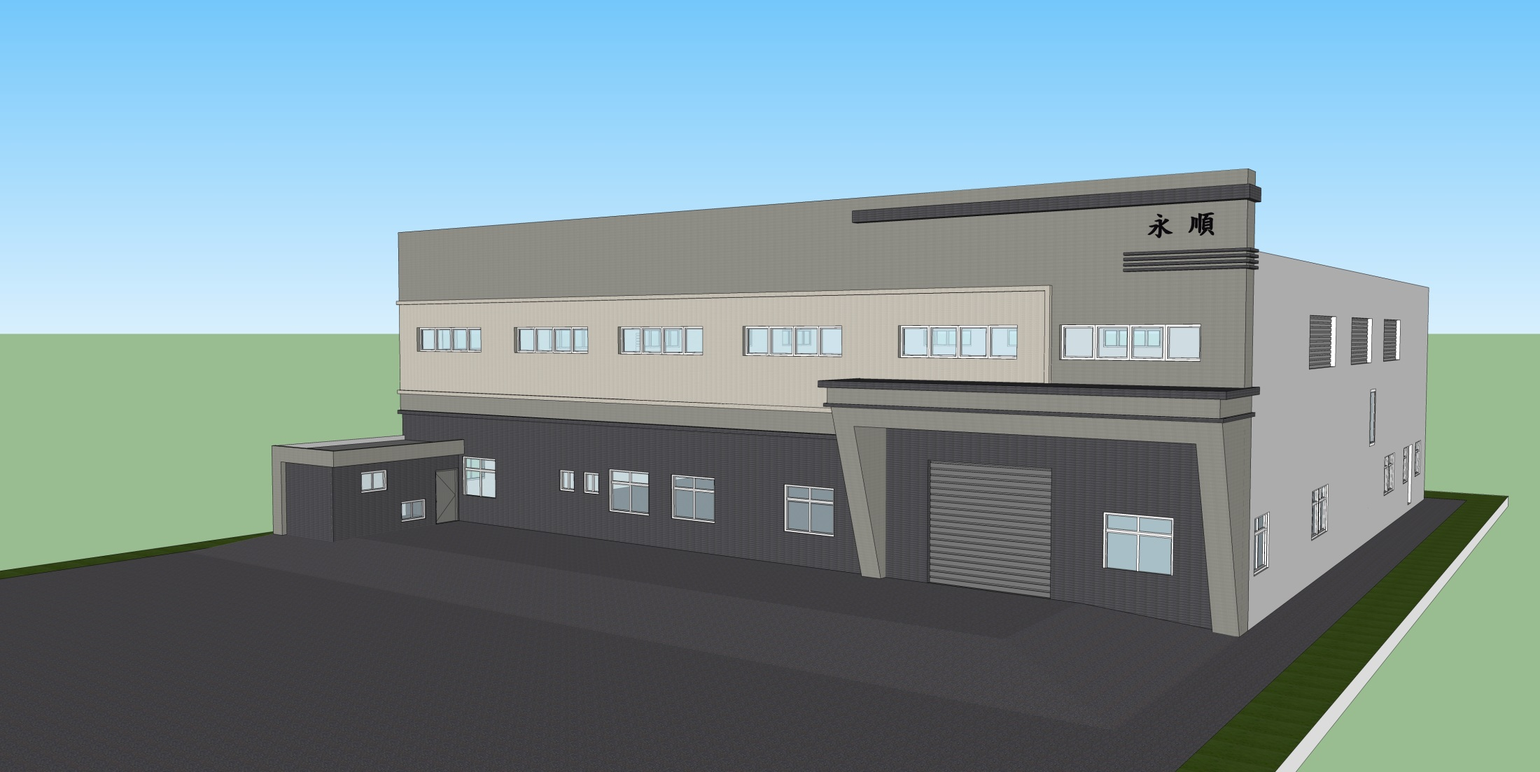
YO Bronze Foundry
Height:12m

Slide 8
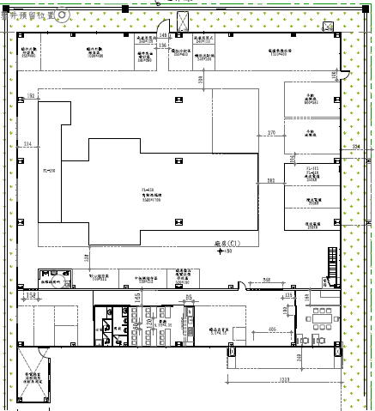
Foundry Layout

Slide 9
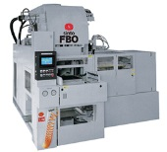
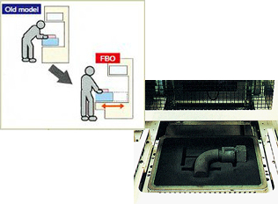
Automatic Sand Molding System
Sand Molding Machine
Be consisted of
Sand Molding Machine
Molds Transportation Device
The sand supply and control

Slide 10
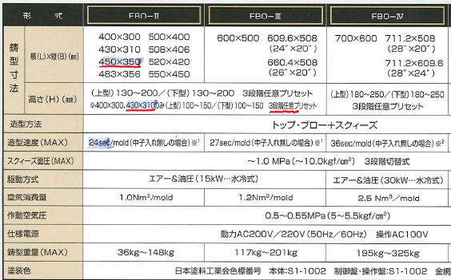
Automatic sand casting machine

Slide 11
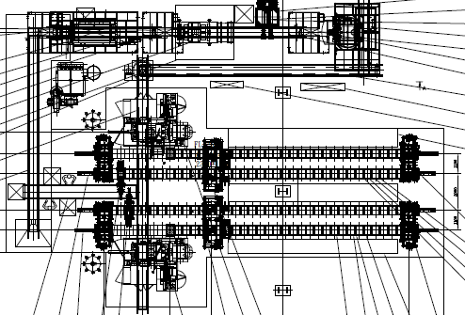
Automatic Sand Molding System

Slide 12
Sand Molding Line Demo
Case Demo

Slide 13
Benefit
1. Molding speed increase
(Manual=>Mechanized)
22~26/Hr => 70~75/Hr
2. Roughcast appearance will be more
upright position
3. Roughcast q’ty will be increase 40%
if mold renew
4. The sand control will be easier

Slide 14
Construction Estimate Time
2018/1 2~2019/5：Building & Layout design
2019/6~2019/9：Construction License Approved
2019/10~2020/7：Plant Construction & Approved
2020/8~2020/11：Machine Setup
2020/12~2021/1：Try Run

Slide 15
Robot for load&unload
Middle Volume ：Q’ty>4000pcs
Location：Old Foundry
Machine：6-spindle Lift Tapping Machine
Demo Video

Slide 16
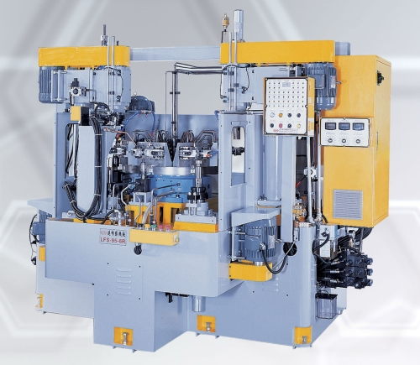
New Tapping Machine
2020-2021
6 spindle Rotary Table Tapping Machine
Tapping Q’ty increase：
630~700pcs/day
=>1260-1400pcs/day
Video Demo

